Slide 1
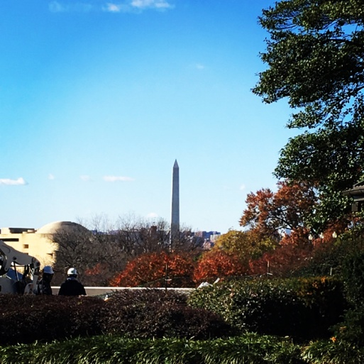
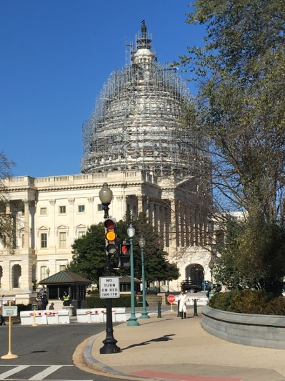

How to increase research impact through developing and disseminating health policy briefs: a guide for SIGs
Akilah Dulin, PhD
SBM Health Policy Committee,
Member
Joanna Buscemi, Ph.D.
SBM Health Policy Committee,
Chair

Slide 2
Have you ever thought…
I want my work to have more impact.
These relatively small randomized controlled trials give us important data but how can I help more people?
Even if interventions are effective, how can people keep up behavior change given our environment and policy challenges?
How can I increase my role in advocacy?
My background is not in health policy. How can I participate and make an impact anyway?

Slide 3
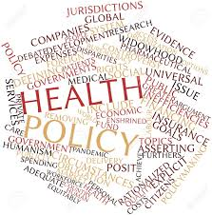
Health Policy Committee of SBM
Joanna Buscemi, Ph.D., Chair
Amanda Blok, PhD
Akilah J. Dulin Keita, PhD
Edwin B. Fisher, PhD
Marian L. Fitzgibbon, PhD
Laura L. Hayman, RN, PhD, FAAN
Judith K. Ockene, PhD Med
C. Tracy Orleans, PhD
Lisa M. Quintiliani, PhD, RD
Kenneth Tercyak, PhD
Dawn K. Wilson, PhD
Amy L. Yaroch, PhD

Slide 4
Health Policy Committee of SBM
“The Health Policy Committee identifies, assesses and develops key opportunities to inform the policy debate at the federal and state level on issues related to the SBM mission.“
“The Committee may develop policy positions for the society to be reviewed and approved by the Executive Committee acting for the Board. These shall highlight the contributions of behavioral medicine in advancing healthcare and public health.”

Slide 5
Health Policy Briefs
Health Policy Committee Briefs
SBM takes a position on a current issues affecting policy in behavioral medicine
Collaborations between committee members, experts in the field, and SBM SIG Members
Early career investigators can take the lead with expert mentorship
Drafts are reviewed and discussed on monthly calls
Approved by Health Policy Committee, then Executive Committee

Slide 6
Policy Brief Procedure
Policy Brief Procedure
Committee or Staff develops an idea
Experts are contacted
Relevant SIGs are contacted for collaboration
Notes:
It used to be that most of the ideas for policy briefs came from the cmte or staff. But over the last few years we have contacted relevant SIGs to get expert opinions on briefs as well. We found that sigs had a lof of their own ideas for briefs and we could develop more briefs if we allowed SIGS and members to propose their own ideas so now a lot of the ideas come from members like you instead of from the cmte or SBM staff.
But you can start the process too!

Slide 7
Policy Brief Procedure
Policy Brief Procedure
Committee or Staff develops an idea
Experts are contacted
Partner with like-minded organizations!!
Relevant SIGs are contacted for collaboration
Notes:
Now we partner with like-minded organizations to increase the reach and dissemination of our briefs

Slide 8

What is a Health Policy Brief?

Slide 9
What is a Health Policy Brief?
“Concise summary of a particular issue, policy options to deal with it, recommendations for future legislation…”
“Document presenting findings and recommendations of research to a non-specialized audience…”
“…Means for exploring all sides of an issue”
“A vehicle for providing policy advice…”
NOT A RESEARCH BRIEF

Slide 10

Format of a Health Policy Brief
Brief background
Summary of issues- Statement of Problem
Evidence
Current state of policy
Summary
Recommendations

Slide 11
Examples of SBM’s recent policy briefs

Slide 12

Enact Taxes on Sugary Drinks to Prevent Chronic Disease
Taber, D. et al. (2018). Translational Behavioral Medicine (in press).
SBM Brief: bit.ly/2nfDqER
Notes:
Link to BE

Slide 13
Background
Sugary drinks increase risks for chronic diseases
Sugary drinks are the largest source of added sugars in the U.S.
  Particularly important for low-income and some ethnic minority youth.
Sugary drink taxes reduce consumption and associated chronic diseases.

Slide 14
Problem: What type of tax is effective. Pushback by beverage industry.
Notes:
Pushback has been children don’t like the foods and plate waste has increased

Slide 15
SBM Recommends
Utilizing sugary drink taxes to reduce consumption
Implementing an excise tax of at least 20%
Monitoring industry and consumer behavior in response to the tax.

Slide 16
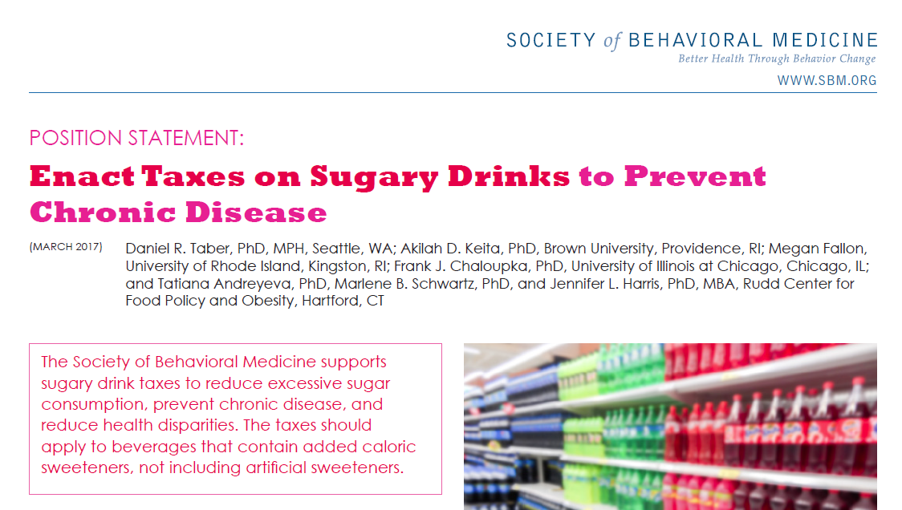

Slide 17
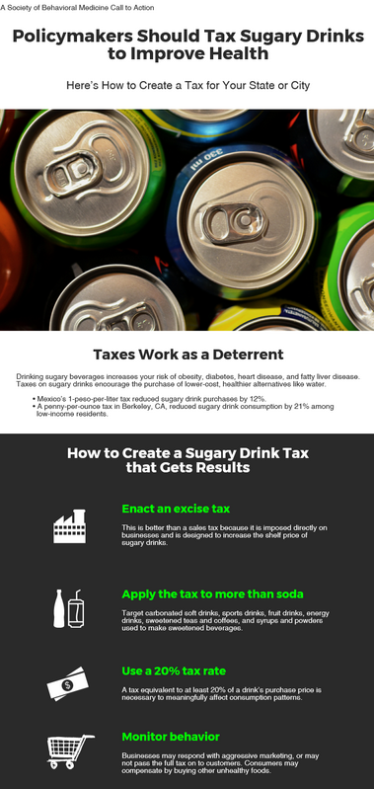

Slide 18
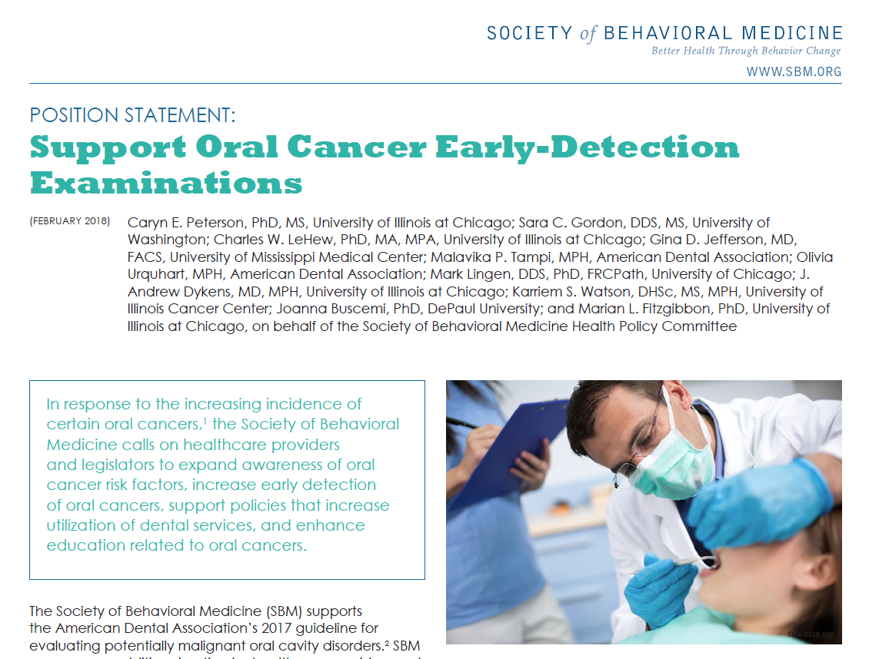

Slide 19
SBM Recommends
Expanding of oral cancer risk factors
Increasing early detection of oral cancers
Supporting policies that increase utilization of dental services
Enhancing education related to oral cancers

Slide 20
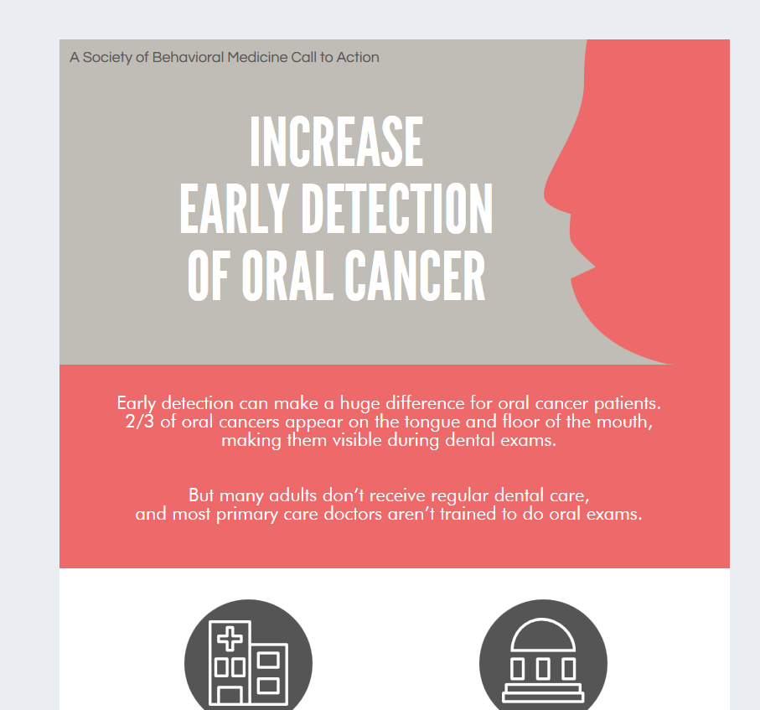

Slide 21
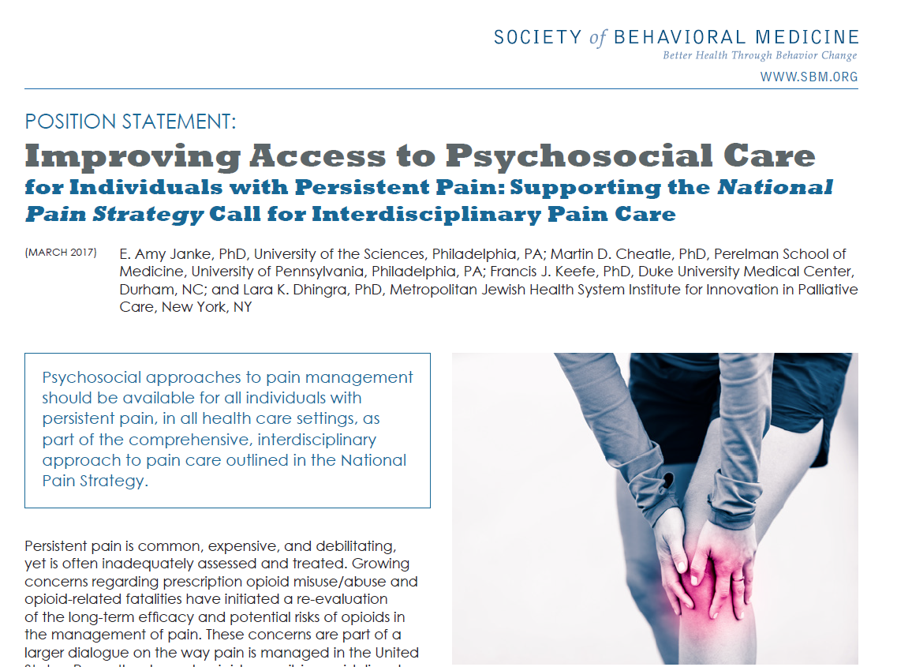

Slide 22
SBM Recommends
Psychosocial approaches to pain management should be available
  For all individuals with persistent pain
  In all health care settings
  As part of the approach to pain care outlined in the National Pain Strategy

Slide 23
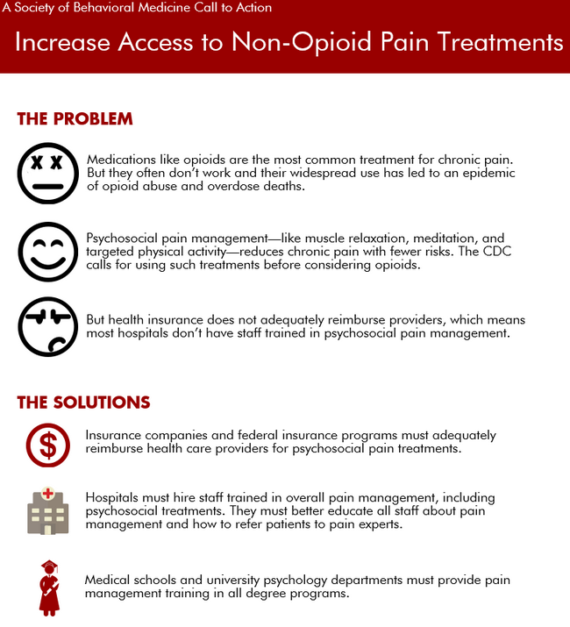

Slide 24
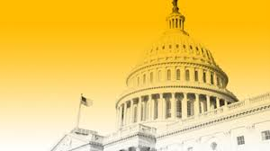
What makes a brief an effective brief?

Slide 25
What makes a brief an effective brief?
Briefs are BRIEF
Lay language
Summary of research to support recommendations
Know your audience!
Make sure the audience can do something about recommendations!
Notes:
All expressed within 2 to 3 pages

Slide 26
What makes a brief an effective brief?
6. Not all issues need to be covered, but issues related to recs do!
7. Timely
8. Plenty of evidence to support your point of view
9. Addresses an important problem- important to SBM mission
10. Clearly stated position

Slide 27
Policy Brief Procedure
Policy Brief Procedure
Committee or Staff develops an idea
Experts are contacted
Partner with like-minded organizations!!
Relevant SIGs are contacted for collaboration
Notes:
The purpose of this slide is to reinforce that we partner with like-minded organizations and then transition into why engage with partners.

Slide 28





Why Engage Partners?
Develop relationships for future collaboration
Increase the impact of the briefs
Receive broader expert feedback on briefs
Notes:
Receive broader expert feedback on briefs – when involved from the beginning, more jointly co-authored (this has led to significant delays and or provide co-endorsement

Slide 29
Dissemination
Dissemination
Post on SBM Site
Partner with relevant organizations
Social media
Submit to Translational Behavioral Medicine for publication
Share with legislative aides on Capitol Hill visits
Notes:
TBM is peer-reviewed publication.

Slide 30
Dissemination
Dissemination: Reach
Notes:
TBM is peer-reviewed publication.

Slide 31
Dissemination
Position Statement | Clicks on SBM website | Twitter | Facebook
Increase Funding for Fruit and Vegetable Production in Farm Bill Reauthorization | 305 plus 97 on infographic | Retweets: 19 Likes: 18 Reach: 6,602 *post from Brown Public Health had 3 retweets and 8 likes. | Likes: 13 Shares: 2 Reach: 958
Start Middle and High Schools Later | 339 plus 178 on infographic | Retweets: 37 Likes: 30 Reach: 4,678 *21 non-SBM accounts shared 37 posts, and those had a collective 132 retweets and 192 likes. | Likes: 25 Shares: 1 Reach: 3,356 *7 posts from endorsing partners had collective 156 likes and 81 shares.
Medicaid/CHIP Safety Net Support | 205, plus 124 on infographic | Retweets: 12 Likes: 23 Views: 2,595 (No endorsing partners) | Likes: 9 Shares: 4 Views: 1,688 (No endorsing partners)
Dissemination
Notes:
Based on April 2018 report.

Slide 32
Position Statement | Clicks on SBM website | Twitter | Facebook
Support Policies to Reduce Smoking Disparities for Gender and Sexual Minorities | 138 plus 68 on infographic | Retweets: 13 Likes: 10 Reach: 2891 *Pride Action Tank tweeted and had 3 RTs, 5 likes. | Likes: 10 Shares: 4 Comments: 1 Reach: 2288
Improving Access to Psychosocial Care for Individuals with Persistent Pain | 361 plus 81 on infographic | Retweets: 22 Likes: 24 Reach: 3453 *Division 38 tweeted and had 4 RTs, 5 likes. | Likes: 16 Reach: 1189
Enact Taxes on Sugary Drinks to Prevent Chronic Disease | 335 plus 136 on infographic | Retweets: 18 Likes: 14 Reach: 3740 *ISBNPA tweeted and had 1 RT, 2 likes. | Likes: 4 Reach: 693
Restore CDC Funding for Firearms and Gun Violence Prevention Research | 114 plus 79 on infographic | Retweets: 11 Likes: 10 Reach: 1619 *SAVIR tweeted and had no interaction. | Likes: 6 Reach: 575

Slide 33
Dissemination
Research to Policy Translation
Research
Practice
Research
Policy

Slide 34
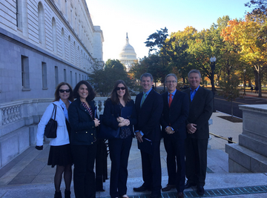
Notes:
SBM Board Members during a capitol hill visit
Marian, Nicole Verrit, Joanna B, David Conroy, Michael Desenbock (red tie, president elect), Brent Van Dorsten

Slide 35
Conclusions
Conclusions
The Health Policy Committee creates and disseminates health policy briefs with the goal of impacting population-level changes in behavioral medicine
YOU can be a part of it!
What policy issues mean the most to you?
You can help to advocate for change

Slide 36
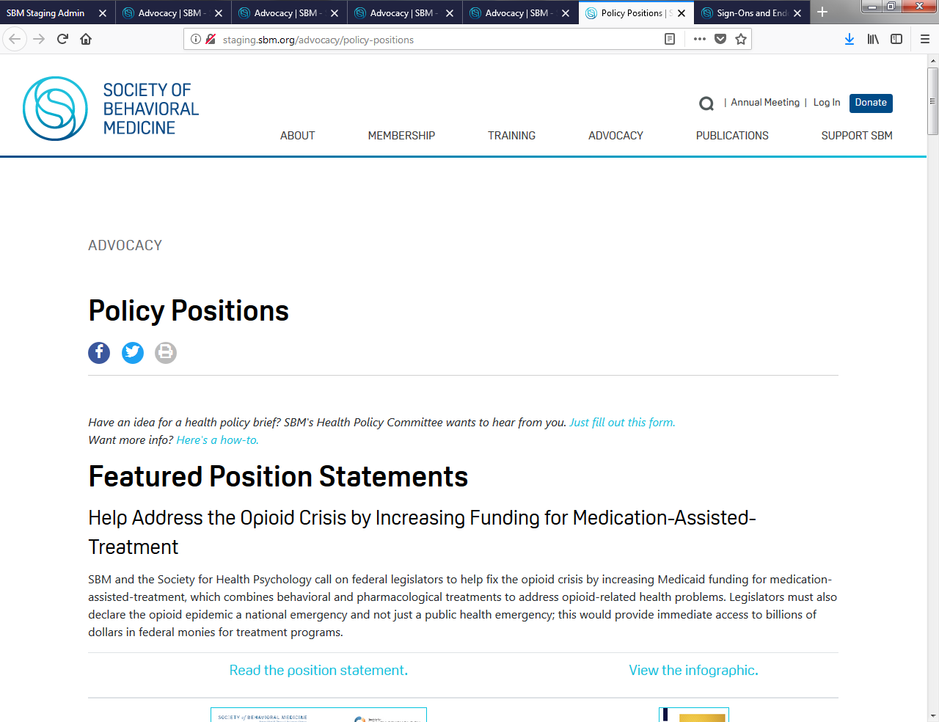
Dissemination
Step 1: Fill out proposal form!

Slide 37

Thank you!
Thank You!
Health Policy Committee
Health Policy Council
Executive Committee
Special Interest Groups
Co-Authors
Partner Organizations
SBM Staff
  Lindsay Bullock

